Slide 1

N0SQL
Not Only SQL Jason Cohn Guggenheim Partners

Slide 2
Our Objective
Openly discuss the purpose and intent of NoSQL Databases
Evaluate several leading NoSQL Platforms
Pilot NOSQL Platform
Pick a platform (or two)
Implement
POC
Evaluate

Slide 3
NoSQL Types – Defined by Implementation
Key Value – Schema-less Key Value Pairs/Collections
Ex. Cassandra
Document Store – Defined by the Document Structure (XML, JSON, PDF)
Ex. MongoDB
Big Table
Ex. Google Big Table
Graph – Designed for data with relationships well represented as a graph
AllegroGraog

Slide 4
Mongo Pros
Better at Single Server Deployment
Can be replicated and has built-in Sharding
Written in C++ and provided in binary form (Cross Platform * Windows)
Robust Drivers
Good fit for JSON Blobs, Stored as BSON
Acts much like a relational databases
Databases and Collections (like Tables)

Slide 5
Cassandra Pros
Better replication technology
Efficient for writes (logging)
Written in Java / Java Friendly
Big Table features (more scalable)
Map/Reduce possible if used with Hadoop

Slide 6
CouchDB Pros
Stores data with JSON documents
RESTful HTTP API for add, edit,delete
Javascript for Query Launguage
Attachment Handling
Built-in Versioning
Futon – Web Administration console
Dynamic Views: embedded map/reduce

Slide 7
Identified Issues
NoSQL Challenge – Everything is pushed to the app
Conflict resolution
Security
Support (Open Source Community vs. Paid Support)
Standards
Where to Host? Linux vs. Windows
Administration
Backups
Audits

Slide 8
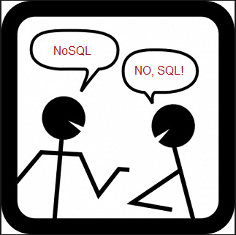
Success Criteria Discussion
Define Success Criteria

